Slide 1


Slide 2
Online auction System
Name : SASIKALA A
GUIDE MAM : SANKARI MSC
CLASS : BSC(COMPUTER SCIENCE) III YEAR SHIFT I
COLLEGE : L.R.G.GOVT ARTS COLLEGE FOR WOMEN

Slide 3
ABSTRACT
Online Auction System project is developed using java, CSS, and JavaScript. Talking about the project, it has almost all the essential features required for a bidding system.
This project contains an admin and user’s side where Admin can manage all the auction activities and product information.
Whereas from the user side, users can view products and bid on it easily. Admin plays an important role in the management of the system. In this project, the user should perform major functions from the Admin side.

Slide 4
Objective
To develop an online auction system which will provide a forum for sellers to meet and interat with buyers, and sell items to interested bidders.

Slide 5
HARDWARE SPECFICATION
Processor : P 4 700 GHz.
RAM : 4 GB RAM
Hard Disk Drive : 180 GB

Slide 6
SOFTWARE SPECIFICATION
Operating System : Windows 7/8/10
Front End : JAVA
Back End : SQL

Slide 7
EXISTING SYSTEM
Now a days when conducting the auction in real time need to spend more time and cost to managing the activities. Need to follow lot of procedure to conducting an auction. No one can interest to join the auction as virtually.
DISADVANTAGES:
Waste of time for conduction
Spend more money to organize

Slide 8
PROPOSED SYSTEM
An online auction project that holds online auctions of various products on a website and serves sellers and bidders accordingly. The system is designed to allow users to set up their products for auctions and bidders to register and bid for various products available for bidding.
ADVANTAGES:
No noisy crowds like conventional system where users have to sit and bid.
Excludes general frustration that usually happens while bidding in conventional system.
No schedule constraint that means bidder can bid any time and from anywhere.
The bidding process can be conducted on a global scale.

Slide 9
Modules
Admin login
Add product
User login
Bidding

Slide 10
Admin Login
Admin has full control of the system, the user should perform major functions from the admin side. Here, the admin can notifications about their products on the bid. Which displays a small message of the user’s account with the placed bid on certain product item. He/she can easily check all the product’s post, end date, the number of bidders, products on bid and bidding logs easily.
Add Product
Another main feature is about adding products to a bid. In order to add products, the admin has to enter the Product name, starting bid price, regular price, select category, product descriptions and upload a product image. It’s simple to add a new product category, admin just has to provide a category name and upload an image file. Without uploading an image here, the system won’t proceed further steps.

Slide 11

User Login
From the user’s side, the user can view each and every product that is available. There are various product categories which divide the products. To bid on a product he/she should log in or register to the system. But after registration, the user should activate his/her account in order to bid on a product. Other bidding rules are the same.
Bidding
A user should enter an amount more than the minimum bid value. If a user enters highest bid amount then the system lists his/her account name in the product’s detail as the highest bid. Before bidding the user can check for product details, image, and bidding logs easily. The system also displays time left to bid and the number of bids.

Slide 12

Data Flow Diagram
Level 0

Slide 13
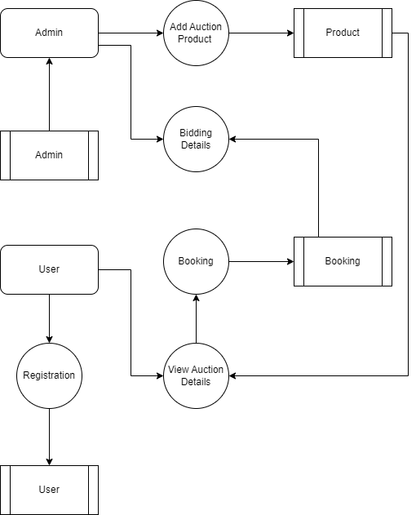
Level 1:

Slide 14
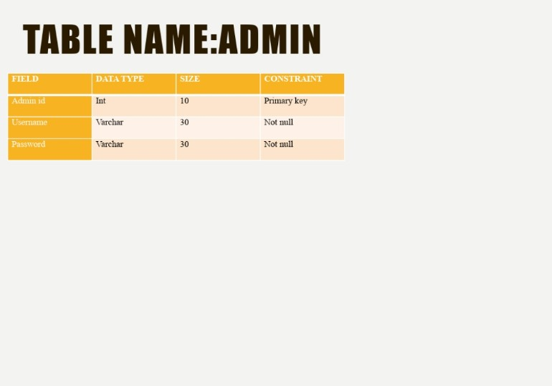

Slide 15
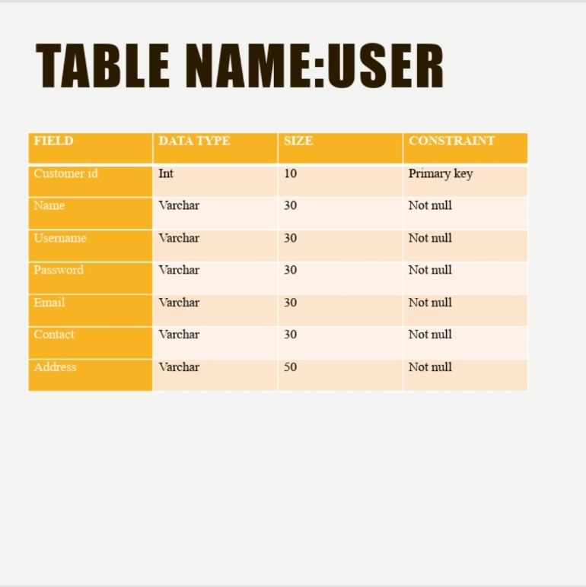

Slide 16
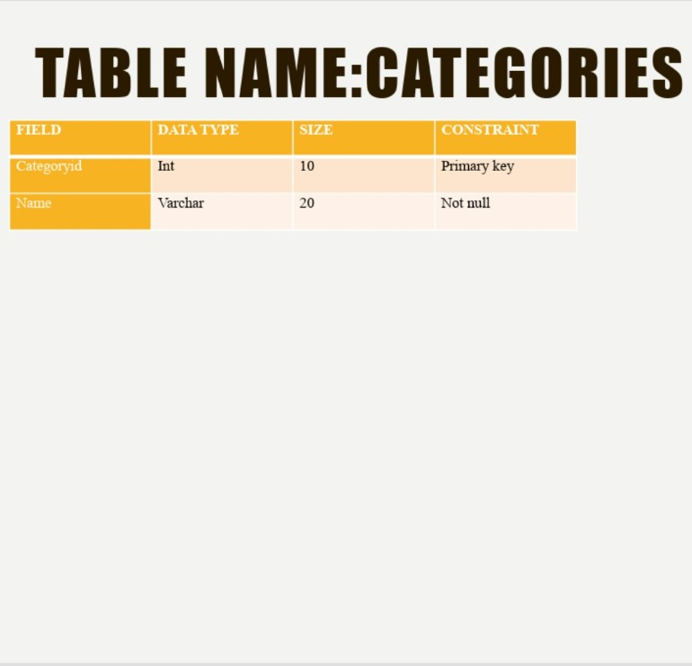

Slide 17
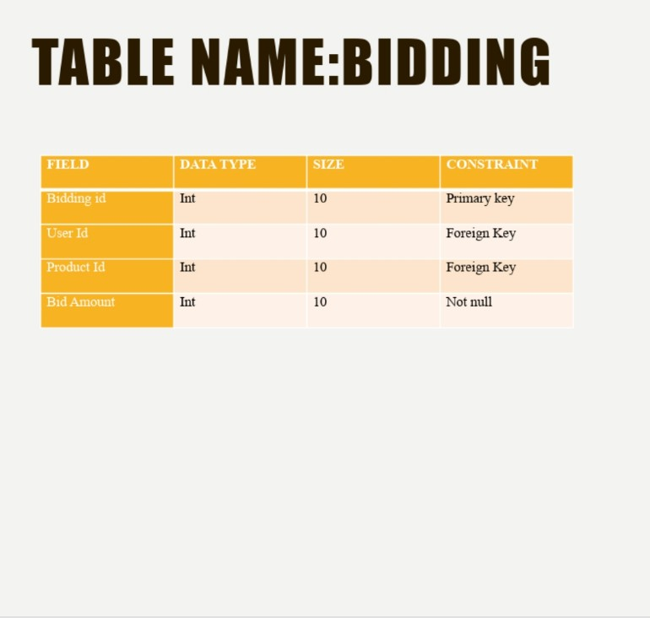

Slide 18
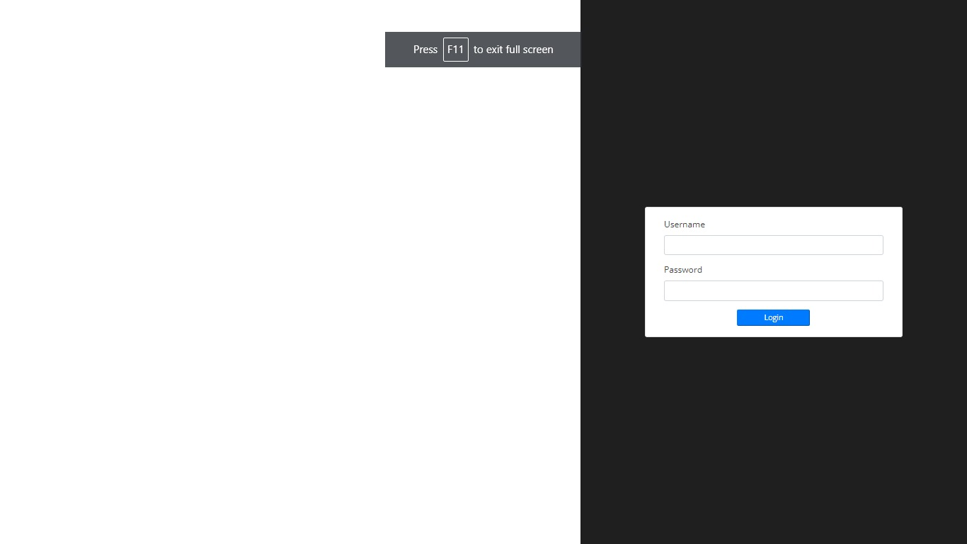

Slide 19
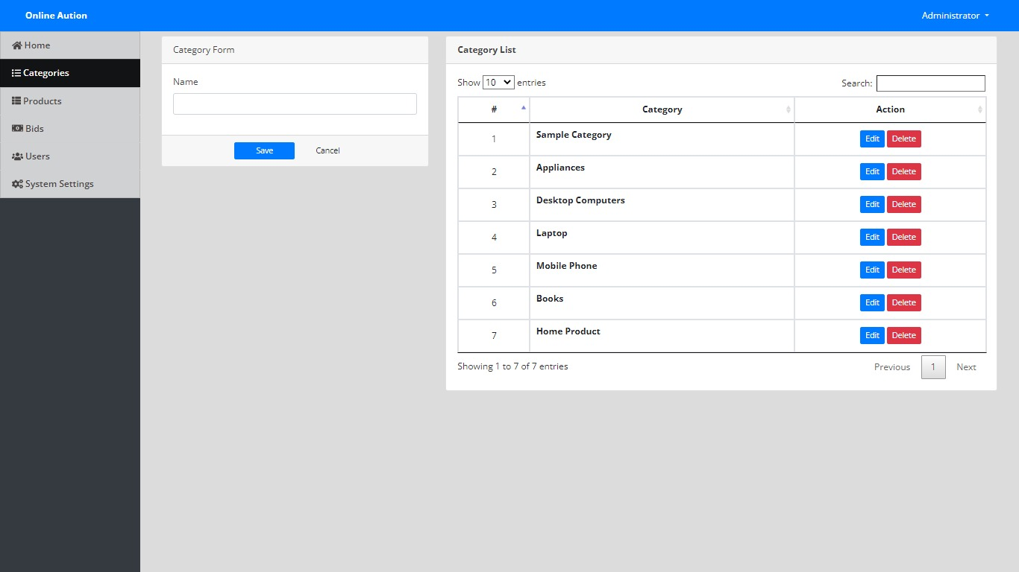

Slide 20
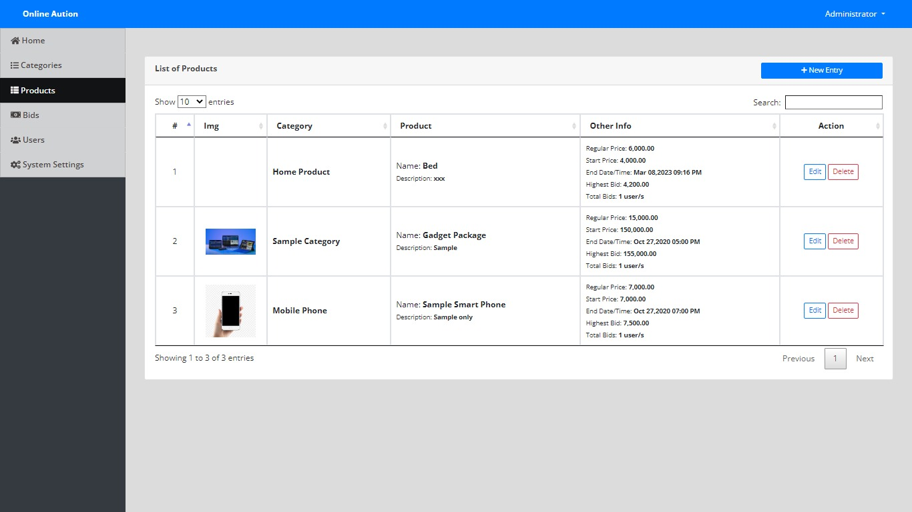

Slide 21
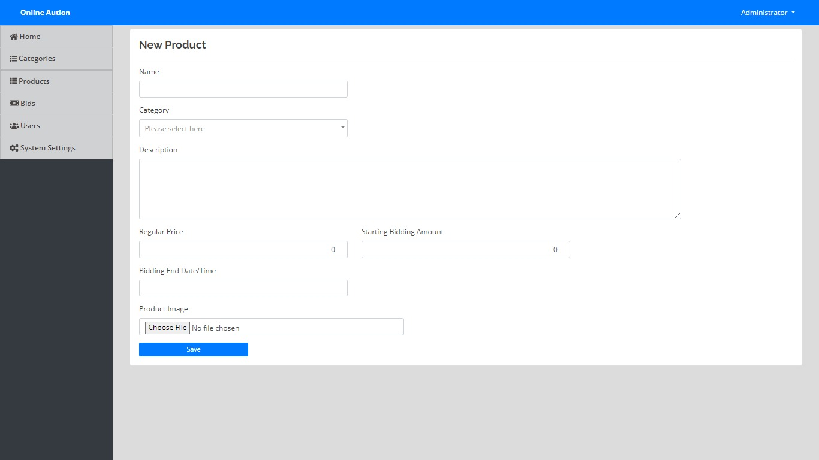

Slide 22
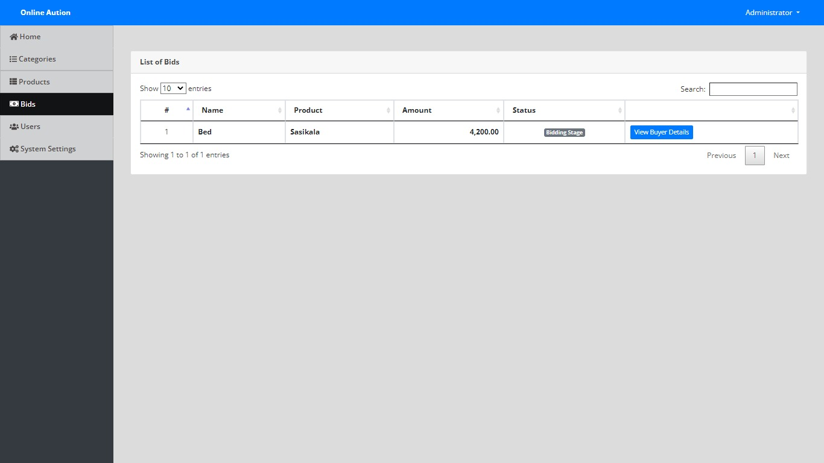

Slide 23
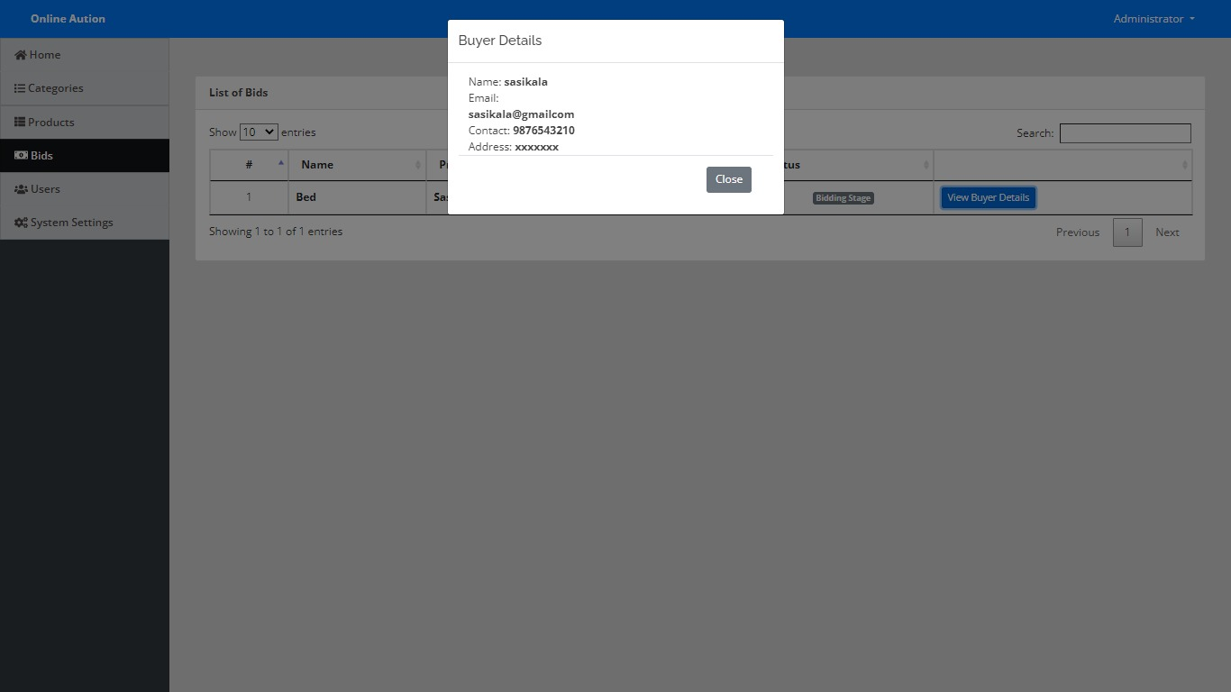

Slide 24
THANK YOU

